Slide 1
Welcome to
Our Class

Slide 2
Monday, May 18, 2020
Unit 10 :
SOURCES OF ENERGY
Period 80: A CLOSER LOOK 1

Slide 3
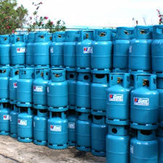
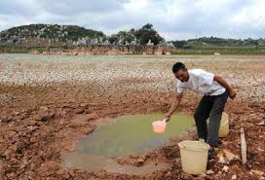
I.Vocabulary:
- limited (a) :
giới hạn, hạn chế
- exhaustible (a) :
có thể cạn kiệt
- harmful (a) :
có hại
- abundant (a) :
nhiều, phong phú
- available (a):
có sẵn để dùng

Slide 4
* Checking vocabulary
- limited (a) :
/ˈlɪm.ɪ.t̬ɪd/
giới hạn, hạn chế
- exhaustible (a) :
/ig'zɔ:stəbl/
có thể cạn kiệt
- harmful (a) :
/'hɑ:mful/
có hại
- abundant (a) :
/əˈbʌn.d^{ə}nt/
nhiều, phong phú
- available (a) :
/ə'veiləbl/
có sẵn để dùng

Slide 5
II.Practice:
1. Matching
* Match the words in A with their opposites in B.
A
B
Example: 1b
1.unlimited
a. polluting
2.abundant
b. limited
3.cheap
c. non- renewable
4.clean
d.exhausted/exhaustible
5.renewable
e. dangerous
6.safe
f. expensive
Answer keys : 1b, 2d, 3f, 4a, 5c, 6e

Slide 6
KIM’S GAME

Slide 7
What sauces of energy can you see in the video ?

Slide 8
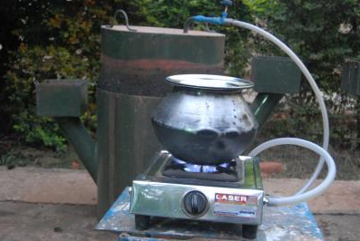
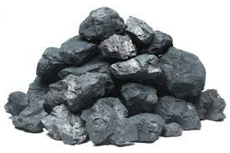
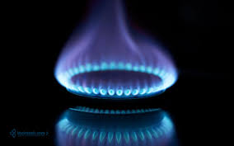
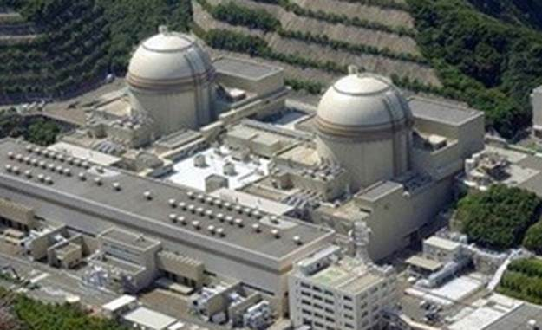
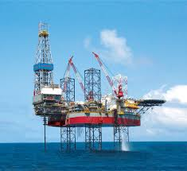
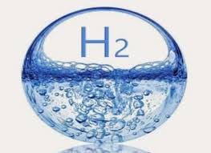
Answer keys
biogas
coal
gas
nuclear
oil
solar
water/ hydro
wind
What are their advantages and disadvantages ?

Slide 9
3.Put the words below into the table to describle the types of energy: (Ex 1/40)
limited
unlimited
harmful
renewable
non-renewable
convenient
exhaustible dangerous abundant
safe
clean
cheap
available
expensive
abundant
SOURCES OF ENERGY | Advantage(s) | Disadvantage(s)
wind
water/ hydro
solar energy
biogas
nuclear
coal/oil/natural gas
abundant, unlimited
not available

Slide 10
3.Put the words below into the table to describle the types of energy: (Ex 1/40)
SOURCES OF ENERGY | Advantage(s) | Disadvantage(s)
wind
water/ hydro
solar
biogas
nuclear
coal/oil/natural gas
abundant, unlimited
not available
clean and safe
expensive, not available
renewable, clean, safe
expensive
renewable, safe, clean
harmful, polluting
renewable, clean
expensive, dangerous
abundant
harmful, exhaustible,
polluting

Slide 11
4. Compare your answer with a partner: (Ex 2/40)
A: solar / renewable.
B: clean/ safe.
Example:
A: I think solar is renewable.
B : Me too. I also think it is clean and safe.

Slide 12
4. Compare your answer with a partner: (Ex 2/40)
A: I think is .
B : Me too. (But)I think it is and .
1
A: Biogas/ renewable
B : abundant/ cheap
2
3
4
A: Coal/ abundant
A: Wind/ renewable
A:Nuclear/ renewable.
B: harmful /polluting
B : abundant/ cheap
B:expensive/dangerous

Slide 13
4. Compare your answer with a partner: (Ex 2/40)
A: coal/ abundant.
B : harmful / polluting
A: I think is .
coal
abundant
B : Me too. But I think it is and .
polluting
harmful

Slide 14
4. Compare your answer with a partner: (Ex 2/40)
A: Wind/ renewable.
B : abundant/ cheap
A: I think is .
wind
renewable
abundant
B : Me too. I also think it is and .
cheap

Slide 15
4. Compare your answer with a partner: (Ex 2/40)
A: Biogas/ renewable.
B : abundant/ cheap
A: I think is .
biogas
renewable
B : Me too. I also think it is and .
abundant
cheap

Slide 16
4. Compare your answer with a partner: (Ex 2/40)
A: Nuclear/ renewable.
B : expensive / dangerous
A: I think is .
nuclear
renewable
dangerous
B : Me too. But I think it is and .
expensive

Slide 17
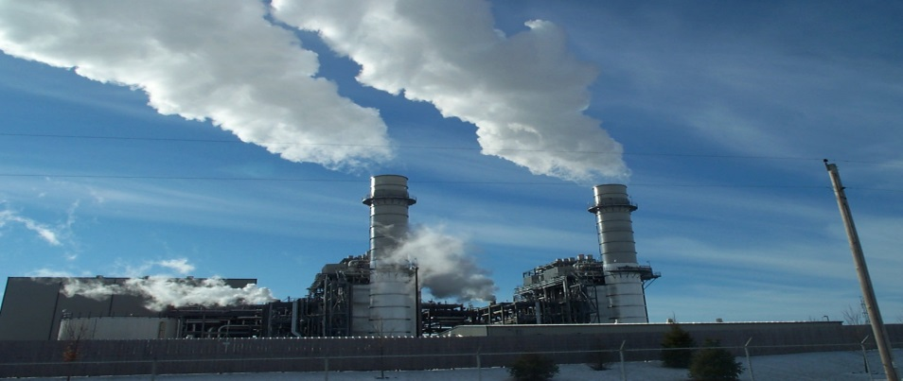
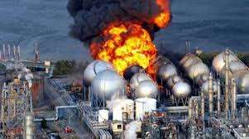
5. Complete these sentences, using the words in 1: (Ex 3/40)
1. ……… energy is renewable.
Moreover, it is clean and…… .
2. Using coal is polluting, and it is….
3. ……………power is abundant.
It is also ………………….and safe.
4. Nuclear energy is renewable and clean.
But it is …………… ……..and……………......

Slide 18
Games

Slide 19
Choose the best answer
Question 1
……............energy is renewable;
Moreover, it is clean and…………..
Solar / safe
Solar/cheap
Solar/ dangerous
Finish
1
5
6
7
8
9
3
4
2
Key
10s

Slide 20
Choose the best answer
Question 2
2. Using coal is polluting, and it is …………..
renewable
non- renewable
clean
Finish
1
2
3
4
5
6
7
8
9
Key
10s

Slide 21
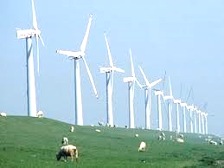
Choose the best answer
Question 3
3. ………power is abundant,
and it is also.…………..and safe.
wind/ cheap
wind/ dangerous
wind/clean
Finish
1
2
3
4
5
6
7
8
9
Key
10s

Slide 22
Choose the best answer
Question 4
4. Nuclear energy is renewable and clean,
but it is .……………….and ……………...
cheap/ clean
expensive/ dangerous
safe/polluting
Finish
1
2
3
4
5
6
7
8
9
Key
10s

Slide 24
Answer keys
1.Solar /
safe
2. non-renewable
3.expensive/
dangerous
4.Wind/
clean

Slide 25
III. Pronunciation:
1.Stress in the three syllable words :
Ooo
oOo
Example:
Ooo
oOo
dangerous
/ˈdeɪn.dʒɚ.əs/
expensive
/ɪkˈspen.sɪv/

Slide 26
III. Pronunciation
2.Listen and repeat :
dangerous enormous limited
easily expensive plentiful
abundant energy convenient

Slide 27
II. Pronunciation
3. Which words are stressed on the first syllable and which ones are stressed on the second syllable? Put them in the appropriate columns.
dangerous enormous limited
easily expensive plentiful
abundant energy convenient
Ooo | oOo

Slide 28
II. Pronunciation
3. Which words are stressed on the first syllable and which ones are stressed on the second syllable? Put them in the appropriate columns.
Ooo | oOo
dangerous easily limited plentiful energy | abundant expensive enormous convenient

Slide 29
Ooo | oOo
dangerous plentiful limited easily energy | expensive abundant convenient enormous
/ˈdeɪn.dʒɚ.əs/
/ɪkˈspen.sɪv/
/ˈplen.t̬ɪ.f^{ə}l/
/əˈbʌn.d^{ə}nt/
/ˈlɪm.ɪ.t̬ɪd/
/kənˈviː.ni.ənt/
/ˈiː.z^{ə}l.i/
/ɪˈnɔː.məs/
/ˈen.ɚ.dʒi/

Slide 30
4. Read the following sentences and mark (‘) the stressed syllable in the underlined words. Then listen, check and repeat.
Coal will be replaced by another renewable source.
Wind power is convenient and abundant.
Natural gas is limited and it is harmful to the environment.
Solar energy is plentiful and it can be replaced easily.
Nuclear power is expensive and dangerous.

Slide 31
5. Read the following sentences and mark (‘) the stressed syllable in the underlined words. Then listen, check and repeat.
Coal will be replaced by a’nother re’newable source.
Wind power is con’venient and a’bundant.
Natural gas is ’limited and it is harmful to the en’vironment.
Solar energy is ’plentiful and it can be replaced ’easily.
Nuclear power is ex’pensive and ’dangerous.

Slide 32
1.What should we do to save the energy ?
2.What types of energy should we use to protect the environment in the future?

Slide 33
Homework:
1. Learn new words by heart
2. Do A1,2 (p. 29), B1,2 (p. 30) workbook
3. Prepare for A closer look 2.

Slide 34
The End
Thanks for your attention – goodbye

